Slide 1




Prediction of employee attrition
Ananth M - 1RV22AI007
Gnyan - 1RV22AI017
Parth - 1RV22AI037
RajLaxmi - 1RV22AI041

Slide 2
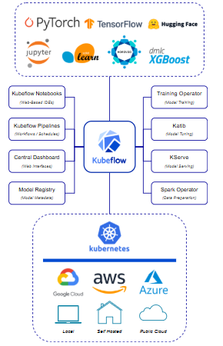
Introduction
Kubeflow is an open-source platform designed to simplify the development, deployment, and management of machine learning (ML) workflows. It provides tools for building end-to-end ML pipelines, including model training, serving, and monitoring.
Developed by Google, Kubeflow leverages Kubernetes to deliver scalable and portable infrastructure, allowing data scientists and engineers to collaborate efficiently on ML projects, ranging from predictive analytics to advanced deep learning.

Slide 3
Introduction (Key Points)
Build and manage end-to-end machine learning workflows :
All seamlessly integrated with Kubernetes.
Made at Google :
For simplifying and scaling machine learning pipelines.
Made with data scientists and ML engineers in mind :
To let teams focus more on innovation and less on managing infrastructure.
High-level tools for defining, deploying, and monitoring ML workflows :
Making it easy to manage reproducible and scalable pipelines.
Supports advanced features like hyperparameter tuning and distributed training :
Includes tools for serving, versioning, and monitoring machine learning models.

Slide 4
Why KubeFlow
Automation
Reduces manual effort by automating repetitive tasks and workflow execution.
Scalability
Dynamically handles workloads of any size, leveraging Kubernetes for efficient resource management.
Collaboration
Modular design allows teams to work on components independently and reuse them across workflows.
Reproducibility
Guarantees consistent results by encapsulating steps in containers and tracking metadata.
Experimentation
Simplifies hyperparameter tuning, experiment tracking, and result comparison for rapid iteration.

Slide 5
Features Of KubeFlow
1. Orchestration and Workflow Management
Built-in tools for orchestrating and managing end-to-end machine learning pipelines.
Ensures pipeline steps are executed in sequence and on schedule.
2. Scalability and Portability
Leverages Kubernetes for scalable and distributed training and inference.
Runs seamlessly across on-premises, cloud, or hybrid environments.
3. Support for ML Frameworks
Compatible with popular frameworks like TensorFlow, PyTorch, Scikit-learn, and XGBoost.
Provides flexibility to use the right tool for the task.
4. Reproducibility and Versioning
Tracks pipeline versions, experiments, and artifacts automatically.
Ensures results are reproducible across different environments.

Slide 6
Features Of KubeFlow
5. Hyperparameter Tuning
Includes Katib, a tool for automating hyperparameter optimization.
Supports multiple algorithms like grid search, random search, and Bayesian optimization.
6. Model Serving and Deployment
Simplifies serving with tools like KFServing for deploying and managing models.
Supports REST and gRPC interfaces for production-grade deployments.
7. Open-Source and Community-Driven
Backed by a strong open-source community with continuous updates and enhancements.
Supported by enterprise adopters and contributors for long-term growth.
8. Visualization and Monitoring
Provides interactive dashboards for pipeline monitoring and management.
Integrates with TensorBoard for model performance visualization.

Slide 7
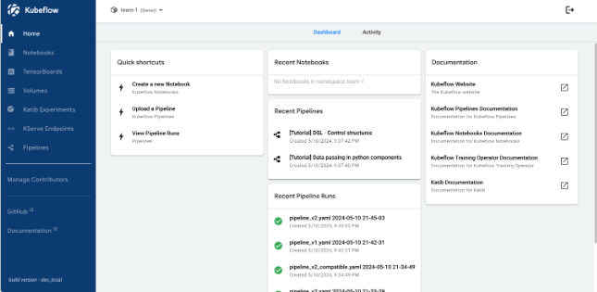
KubeFlow Dashboard

Slide 8
Pros Of KubeFlow
End-to-End ML Support:
Handles the complete ML lifecycle, from data preparation to model deployment.
Scalability:
Leverages Kubernetes for scalable and distributed workflows.
Framework Agnostic:
Supports popular ML frameworks like TensorFlow, PyTorch, and Scikit-learn.
Portability:
Runs on any Kubernetes-supported infrastructure, including cloud and on-premises.
Reproducibility:
Ensures consistency with automatic experiment and artifact tracking.
Customization:
Offers flexibility to design custom components and workflows.
Community and Ecosystem:
Backed by a strong open-source community for continuous updates and improvements.

Slide 9
Cons Of KubeFlow
Complex Setup:
Initial installation and configuration can be challenging for beginners.
Learning Curve:
Requires knowledge of Kubernetes, which may be steep for data scientists without DevOps
experience.
Resource-Intensive:
Demands significant infrastructure, which can be costly for small-scale projects.
Overhead for Small Projects:
Better suited for large, scalable ML workflows than smaller, simpler tasks.

Slide 10
Hardware Requirements
CPU
Minimum: Dual-core processor (e.g., Intel Core i3 or AMD Ryzen 3)
Suitable for small-scale deployments and light workloads.
Recommended: Quad-core processor or higher (e.g., Intel Core i5/i7 or AMD Ryzen 5/7)
Essential for running production-grade workloads and managing distributed tasks efficiently.
RAM
Minimum: 4 GB
Adequate for small-scale testing and handling simple workflows.
Recommended: 16 GB or higher
Necessary for processing large datasets, handling multiple pipelines, and ensuring smooth operation under load.

Slide 11
Hardware Requirements
Storage
Minimum: 50 GB of free disk space
Required for storing datasets, Kubeflow metadata, intermediate results, and logs.
Recommended: SSD with at least 256 GB capacity
Provides faster I/O operations, crucial for performance in I/O-intensive workflows.
GPU (Optional, for ML Workflows)
Recommended: A CUDA-enabled GPU (e.g., NVIDIA GTX 1650 or higher)
Accelerates machine learning model training, large-scale data processing, and computationally intensive tasks.

Slide 12
Software Requirements
Operating System
Minimum: Linux-based OS (e.g., Ubuntu 18.04 or CentOS 7)
Required for compatibility with Kubernetes and containerized workloads.
Recommended: Latest LTS version of a Linux-based OS (e.g., Ubuntu 22.04 LTS)
Ensures long-term support, security updates, and improved performance.
Kubernetes
Minimum: Kubernetes 1.21 or later
Necessary for deploying and managing Kubeflow pipelines and components.
Recommended: Kubernetes 1.25 or later
Supports enhanced features, scalability, and compatibility with recent Kubeflow versions.
Container Runtime
Minimum: Docker 19.03 or containerd 1.4
Required for running containerized workloads in Kubernetes.
Recommended: Latest version of Docker or containerd
Ensures compatibility with the Kubernetes version and improved runtime stability.

Slide 13
Software Requirements
Python
Minimum: Python 3.6
Needed for running Kubeflow pipelines and Python-based machine learning tasks.
Recommended: Python 3.8 or later
Provides access to recent features and better library support.
Kubeflow CLI Tool (kubectl):
Minimum: Version 1.21 (matching Kubernetes version)
Recommended: Latest stable version
Used for interacting with Kubernetes clusters.
Browser (for Kubeflow Dashboard)
Minimum: Chromium-based browser (e.g., Chrome 89 or later) or Firefox 87 or later
Required for accessing the Kubeflow UI.
Recommended: Latest version of Google Chrome or Firefox
Ensures compatibility and smooth UI rendering.

Slide 14
Dataset Management
Kubeflow demonstrates robust dataset management capabilities through several key features:
Versioning and Tracking: Integration with tools like Data version control(DVC) or ML Metadata ensures reproducibility by tracking dataset versions and changes.
Modular Pipelines: Clear separation of stages such as data loading, preprocessing, and model training using Kubeflow Pipelines.
Extensible Data Format Support: Handles various data formats through Kubernetes-backed storage and Python libraries for flexibility.

Slide 15
Testing and Deployment Challenges
The implementation of Kubeflow reveals several testing and deployment challenges:
Configuration of multi-version pipelines to handle different workflow requirements and updates.
Artifact management for datasets, models, and metadata using Kubernetes persistent volumes or external storage systems.
Version control and lineage tracking for models and pipeline runs to ensure traceability and reproducibility.
Comprehensive error handling and logging mechanisms across distributed pipeline steps.
Validation of pipeline inputs, such as data quality, schema checks, and resource specifications.
Scalability considerations in distributed processing and model inference for high-demand scenarios.

Slide 16
Data Governance in Kubeflow
Data Validation and Quality Control
Column Validation: Integration with tools like TensorFlow Data Validation (TFDV) for schema checks and anomaly detection, with clear error messages for missing or invalid columns.
Missing Value Handling: Preprocessing steps for imputation or removal, with data cleaning steps tracked via metadata.
Data Drift Detection: Monitoring for data drift using TFDV or custom scripts to trigger re-training.
Data Provenance: ML Metadata (MLMD) tracks data lineage and transformations for reproducibility.
Data Lineage: Kubeflow offers visualisation of data lineage of a particular artifacts

Slide 17
Data Governance in Kubeflow
Logging and Audit Trail
Logging Configuration: Standardized logging with timestamps, hierarchical levels, and component identification via Kubernetes-native tools.
Operation Tracking: Automated tracking of data loading, processing success/failure, and error conditions in pipelines.
Centralized Monitoring: Integration with Prometheus and Grafana for real-time metrics and logs visualization.

Slide 18
Data Governance in Kubeflow
Additional Features
End-to-End Metadata: Comprehensive tracking of artifacts and workflows using MLMD.
Resource Optimization: Autoscaling through Kubernetes for efficient pipeline execution.
Experimentation Support: Comparison and tracking of multiple pipeline runs for reproducibility.
Model Monitoring: KFServing integration for model deployment and performance monitoring.

Slide 19
Some kubernates terms
Pod:A pod is the smallest unit that can be deployed and managed
Namespace: A namespace is a logical unit that organizes, manages, and secures resources within a cluster
Artifacts: Artifacts in Kubernetes are resources that are updated during a deployment or delivery pipeline.

Slide 20
THANK YOU!
FOR YOUR ATTENTION

